Slide 1


Introduction to the Agile Development Process

Slide 2
What is a Software Process?
To be a proficient full stack web developer you also need to develop essential non-coding skills
A full stack web developer needs to be able to understand, communicate and code the whole web application
Software Process: set of related activities or steps that lead to the production of a software product.
Notes:
These activities may involve developing software completely from scratch, though most business applications are not developed this way. New business software is normally developed by modifying or extending already existing systems or by integrating off-the-shelf software.

Slide 3
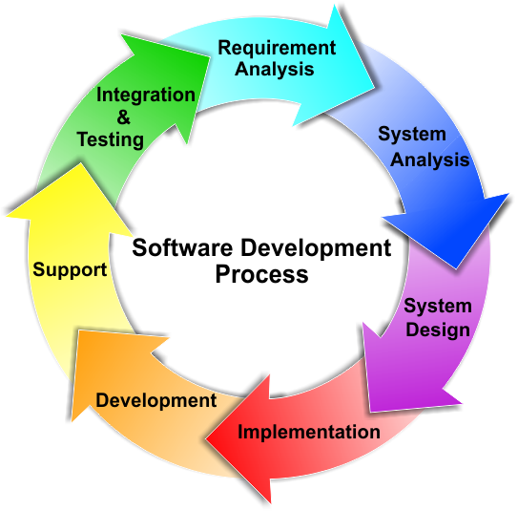
What is a Software Process?
All software processes must include these fundamental activities:
Software specification
Software design and implementation
Software validation
Software evolution
Notes:
Software specification: The functionality of the software and the constraints on its operation are defined.
Software design and implementation: The software is designed and programmed in order to meet the specification.
Software validation: The software is validated to ensure that it does what the customer wants.
Software evolution: The software should evolve to meet the changing needs of the customer. The development of software does not end once it has been deployed.
Software processes are complex and there is no such thing as an ideal process. Processes must evolve in order to take advantage of people's capabilities within an organisation and according to the specific characteristics of the system being developed.

Slide 4
Why Should you Care about Software Processes?
It is not uncommon for software development projects to cost more and take longer to develop than initially anticipated.
Many software systems also don’t always deliver the functionality that the users want
The aim is to deliver systems on time, within scope and within budget
Notes:
People have spent a significant amount of time and effort to find ways to improve this situation which has lead to the development of different software process models; steps that teams of software developers can follow so that they can deliver systems on time, within scope and within budget.

Slide 5
Software Process Models
Software process model: simple representation of a software process
Kinds of process models:
The waterfall model
Incremental development
Reuse-oriented software engineering
We’ll be focusing on incremental development
Notes:
Incremental Model is a process of software development where requirements are broken down into multiple standalone modules of software development cycle. Reuse –oriented software base on reusable components and integrated framework for the composition of these components, that components may provide specific function such as word processing and spreadsheet.

Slide 6
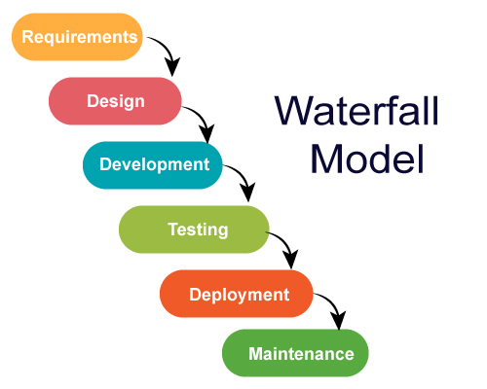
Software Process Models
Notes:
Incremental Model is a process of software development where requirements are broken down into multiple standalone modules of software development cycle. Reuse –oriented software base on reusable components and integrated framework for the composition of these components, that components may provide specific function such as word processing and spreadsheet.

Slide 7
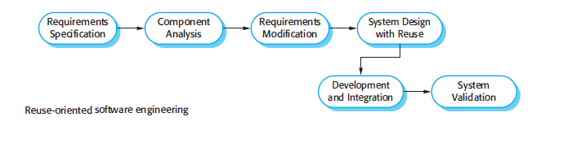
Software Process Models
Notes:
Incremental Model is a process of software development where requirements are broken down into multiple standalone modules of software development cycle. Reuse –oriented software base on reusable components and integrated framework for the composition of these components, that components may provide specific function such as word processing and spreadsheet.

Slide 8
Incremental Development
Involves fundamental activities of specification, development and validation
The system is developed as a series of increments, where each version adds more functionality to the previous version.
An initial version of the system is given to the user for feedback. The system is then evolved through several versions until an adequate system is developed.

Slide 9
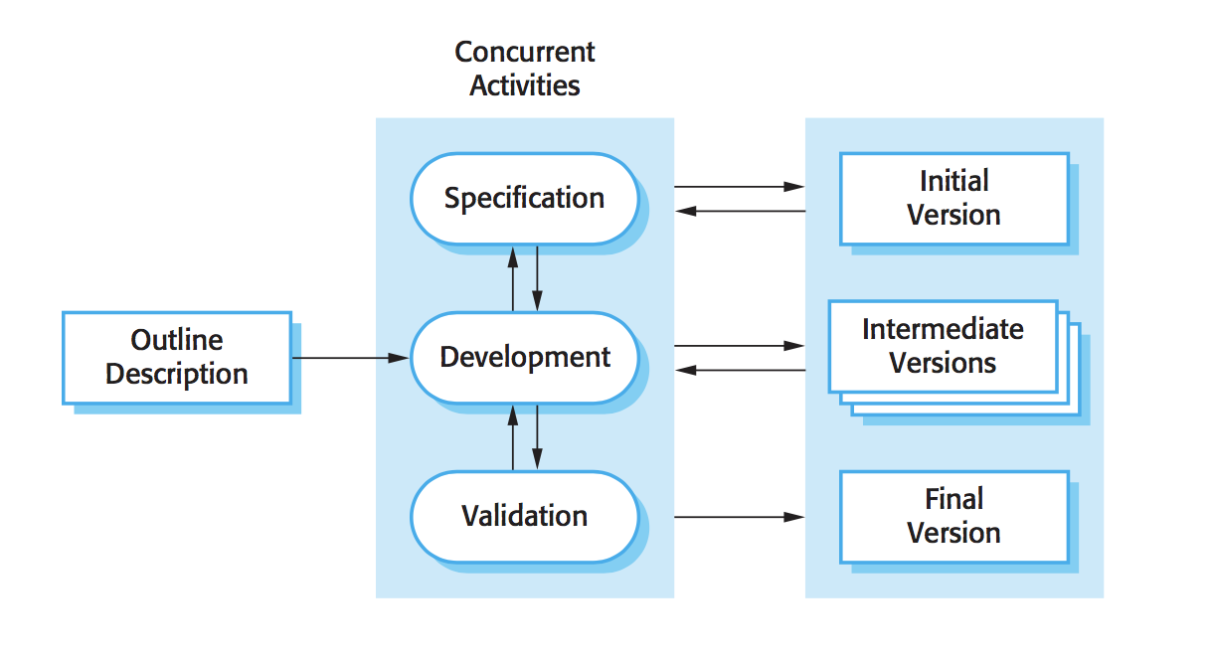
Incremental Development
Incremental Development (Sommerville 2010)
Notes:
The diagram above illustrates the incremental development model. As you can see the specification, development and validation activities occur at the same time with rapid feedback across these activities.
Incremental development is very similar to how we naturally solve problems in that we very seldom work out the whole solution to a problem in advance. Rather, we work towards the solution in a series of steps and backtrack if we make a mistake. Developing software incrementally is cheaper and it is easier to make changes to the software as it is being developed.
Some functionality that is needed by the customer is incorporated into each version of the software. The first versions of the software generally include the most important or most urgently required functionality. Therefore, the customer is able to test the system at an early stage of development to see if it delivers the most important requirements. Only the most recent increment has to be changed if it does not deliver what is required.

Slide 10
Incremental Development
Three benefits of incremental development:
Cheaper to change the system if the customers’ requirements change.
Easier to get feedback from the customer regarding the work that has been done on the system.
Useful software is delivered and deployed more rapidly to the customer, even if all the functionality has not been included.

Slide 11
Incremental Development
Disadvantages of incremental development:
Not as likely to be as well-documented as when other approaches are used.
Documentation is needed to measure the progress of development.Iif the system is developed too quickly, it is not cost-effective to produce documents that reflect all versions
As new increments are added, the structure of the system tends to degrade and a lot of time and money will therefore be needed to improve the software.
Notes:
Large, complex systems compound the problem faced by incremental development. These systems, which usually have a long lifespan, are worked on by many different teams of engineers. The responsibilities of the different teams need to be clearly defined with respect to architecture since large systems need a stable architecture. This has to be planned in advance and not developed incrementally.

Slide 12
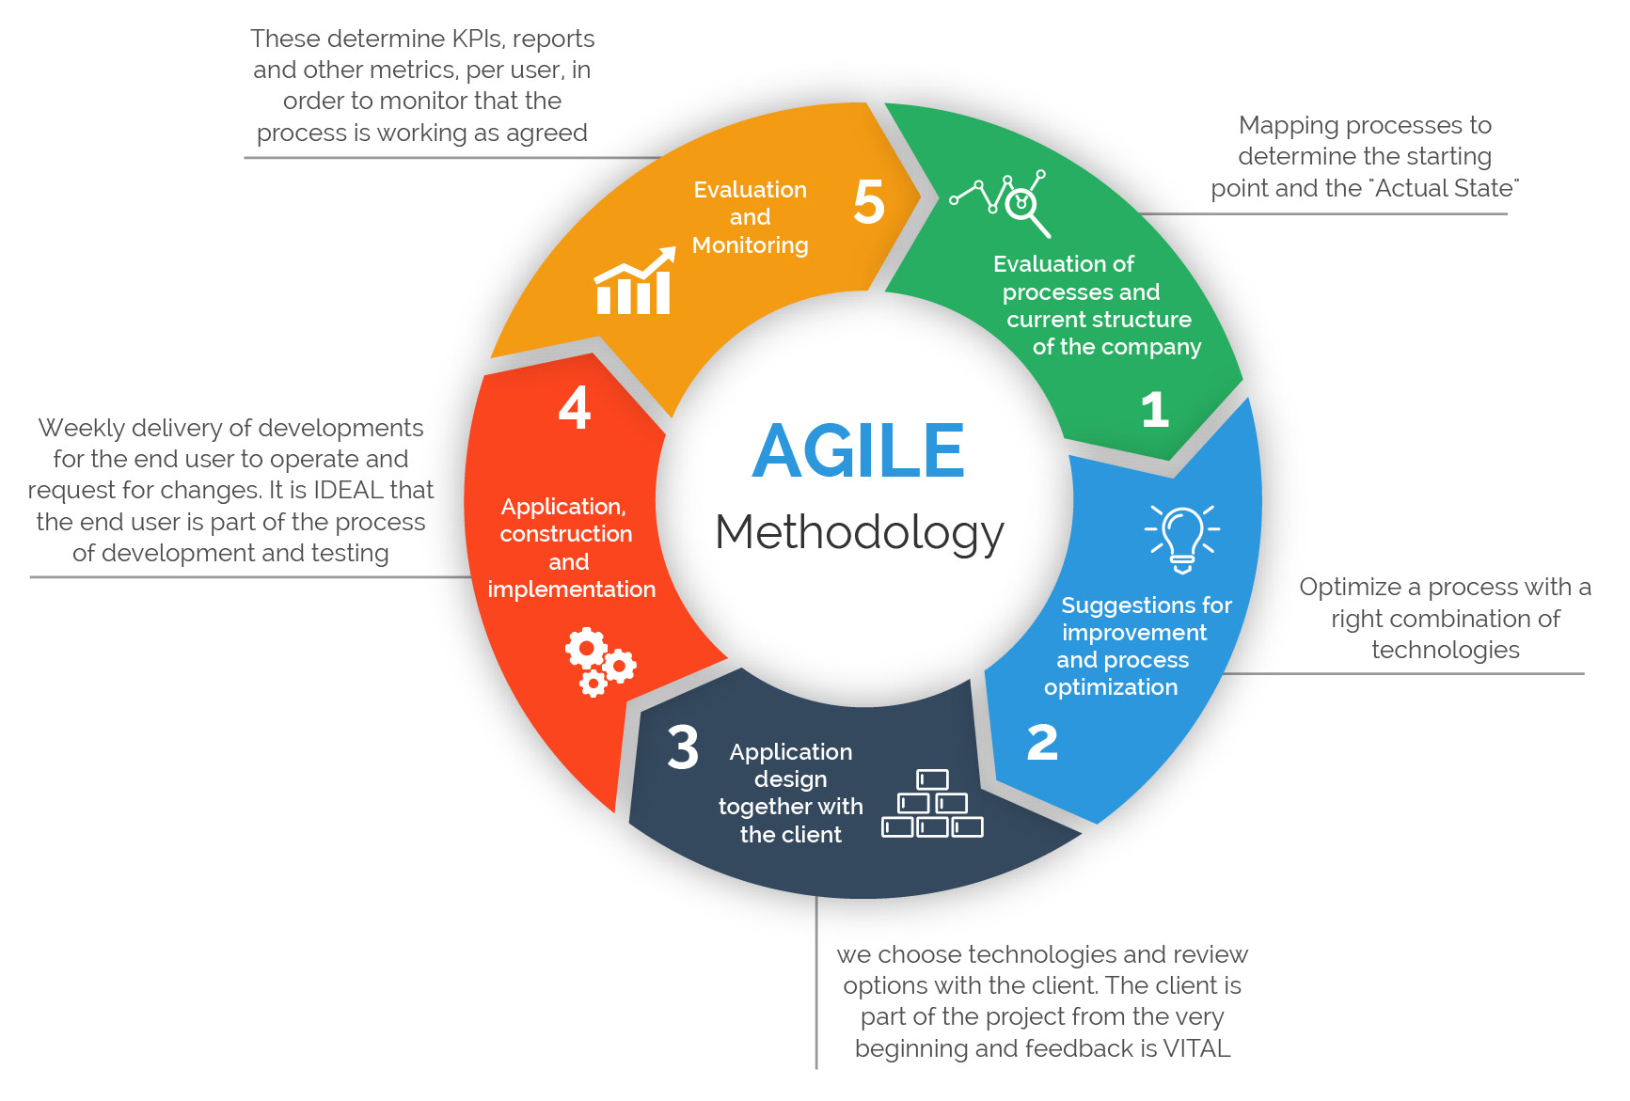
What is Agile?
Agile methods: incremental development methods in which changes are made in small increments
New releases of the system are created and made available to customers every two or three weeks
Involve customers in the development process to get rapid feedback on changing requirements
Minimize documentation by using informal communications
Notes:
Today, software is part of almost all business operations. This software needs to be developed quickly in order to take advantage of new opportunities and to respond to competitive pressure in a rapidly changing business environment. Therefore, the most critical requirement for software systems nowadays is often rapid development and delivery. Some companies are even happy to trade software quality and compromise on requirements in order to achieve faster deployment of the software.

Slide 13
What is Agile?
Agile development refers to a number of different iterative and incremental software development methodologies:
Extreme Programming (XP) (best known)
Scrum
Crystal
Dynamic Systems
Development Method (DSDM)
Lean Development
Feature-Driven Development (FDD)

Slide 14
What is Agile?
Agile methodologies were successful for some types of system development:
A software company is developing a small- or medium-sized product
Custom system development within an organization, where the customer is keen to be involved in the development process and where there are not a lot of external rules and regulations that affect the software.

Slide 15
Extreme Programming (XP)
Pushes recognized good practice, such as iterative development, to “extreme” levels
XP expresses requirements as user stories
These are implemented directly as a series of tasks
Tests for each task are developed by a pair of programmers before any code is written
When new code is integrated into the system, all these tests must be executed successfully
Notes:
For example, in a single day, several new versions of a system can be developed, integrated and tested, with XP.

Slide 16
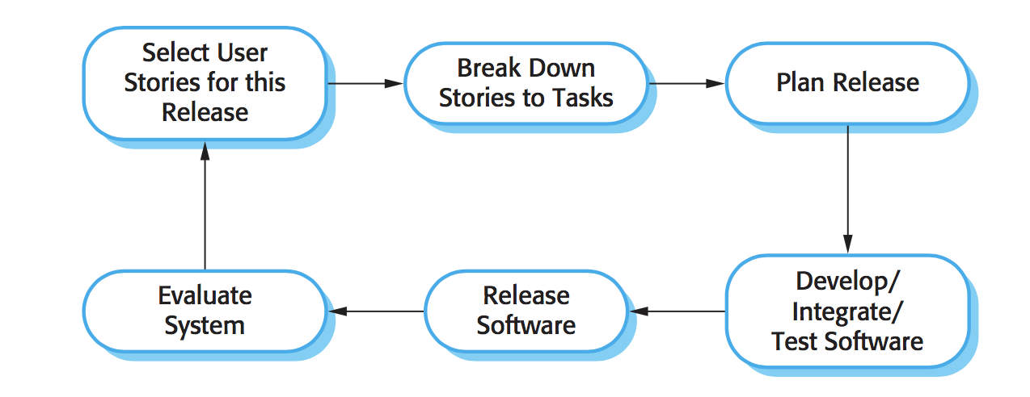
Extreme Programming (XP)
The XP release cycle (Sommerville 2010)

Slide 17
Extreme Programming (XP)
XP involves practices from the Agile Manifesto:
Incremental development
Customer involvement
People, not processes
Change is embraced
Maintaining simplicity
Notes:
Incremental development: The system is released in small frequent intervals. Requirements are based on simple customer stories or scenarios which are recorded on Story Cards and used as a basis for deciding what functionality to be included in the system increment.
Customer involvement: The customer is constantly engaged in the development team. A customer representative takes part in the development and is responsible for defining the acceptance tests for the system.
People, not processes: Programming is done in pairs and the entire development team takes collective ownership of the system code. The development process also does not involve excessively long working hours.
Change is embraced: This is done through regularly releasing the system to customers and designing tests before code is written. The code is also refactored once possible code improvements are found. Refactoring is the process of restructuring existing computer code in order to avoid code degeneration. New functionality is also constantly integrated.
Maintaining simplicity: The constant refactoring of code improves code quality and simple designs are used that do not unnecessarily anticipate future changes to the system.

Slide 18
Extreme Programming (XP)
Customer is part of the development team and discusses scenarios
All team members develop a “story card”
The team implements a scenario in a future version
Story cards are broken down into tasks. The effort and resources needed for each task is estimated
If new changes come to light, new story cards need to be developed and the customer decides whether these changes should have priority over new functionality
Notes:
Once the story cards have been developed, the development team then breaks these down into tasks and estimates the effort and resources required for implementing each task. The customer is usually consulted on ways to refine the requirements and prioritise the stories for implementation. Stories that can be used immediately to deliver useful business support should be implemented first. If new changes come to light, new story cards need to be developed and the customer needs to decide whether these changes should have priority over new functionality.
A “spike” is an increment in which no programming is done. This can be due to the team carrying out prototyping or trial development to better understand a problem and try to find a solution. A “spike” may also occur if the team needs to design the system architecture or to develop system documentation.
With Extreme Programming, new versions of the software are delivered to customers roughly every two weeks and several new versions of the software can be built in a single day. The deadlines for releases are never missed. If the development teams experience any problems in the process, the customer is immediately consulted and some functionality is removed from the upcoming release.

Slide 19
Testing in XP
The XP approach to testing reduces the chances of introducing errors that were not discovered in the current version of the system.
Key features:
Test-first development
Incremental test development from scenarios
User involvement in the test development and validation
The use of automated testing frameworks
Notes:
This is one of the most important innovations in XP. Rather than writing some code and then writing tests for that code, you write the tests first. By doing this, you can run the test as the code is being written and discover problems during development.
In test-first development, the team members who have been assigned to implement a task have to thoroughly understand the specification so that they are able to write tests for the system. This means that any omissions or ambiguities in the specification have to be clarified before implementation begins. It also avoids “test-lag” which happens when the developer works faster than the tester. When “test-lag” occurs the implementation of the system gets further and further ahead without any testing. Tests are often skipped to keep the project on schedule.
The development team assesses each scenario that expresses the user requirements and breaks it down into tasks. One or more unit tests are generated for each task. These unit tests check the implementation described in a specific task.
The customer helps to develop acceptance tests for each of the scenarios that are to be implemented in the next release of the system. With acceptance testing, the system is tested using customer data to check that it meets the customer’s real needs. Like development, the acceptance testing in XP is incremental. As the development proceeds the customer, who is part of the team, writes tests.
For test-first development, test automation is essential. Tests are written as executable components that: should be standalone, should simulate the submission of input to be tested and should check that the result meets the output specification before the task is implemented. An automated test framework makes it easy to write executable tests and submit a set of tests for execution. Since testing is automated, there is always a set of tests that can be quickly and easily executed.

Slide 20
Pair Programming
Programmers sit together at the same workstation and work to develop the software.
Advantages:
It supports the idea of collective ownership and responsibility for the system
It acts as a type of informal review process since each line of code is looked at by at least two people.
It helps support refactoring
Notes:
Some of the advantages of pair programming are:
It supports the idea of collective ownership and responsibility for the system. When the software is owned by the whole team, individuals are not held responsible for problems with the code. The entire team has collective responsibility for resolving these problems instead.
It acts as a type of informal review process since each line of code is looked at by at least two people. Even though pair programming doesn’t find as many errors, it is a much cheaper inspection process than formal program inspections.
It helps support refactoring, which is a process of software improvement. With pair programming and collective ownership, others benefit immediately from the refactoring so they are likely to be more supportive of the process.

